Slide 1
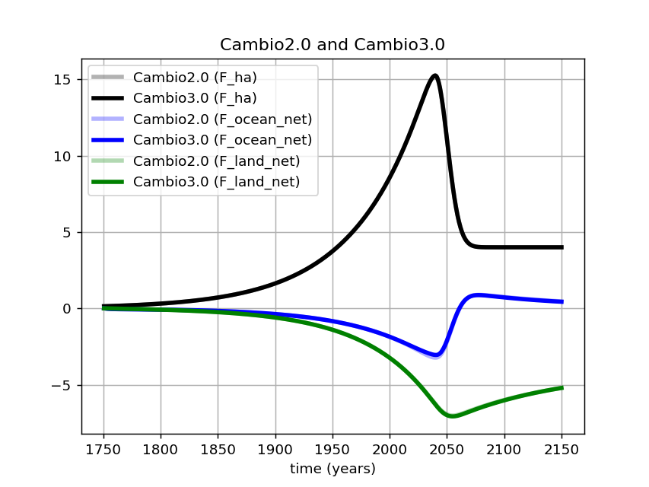
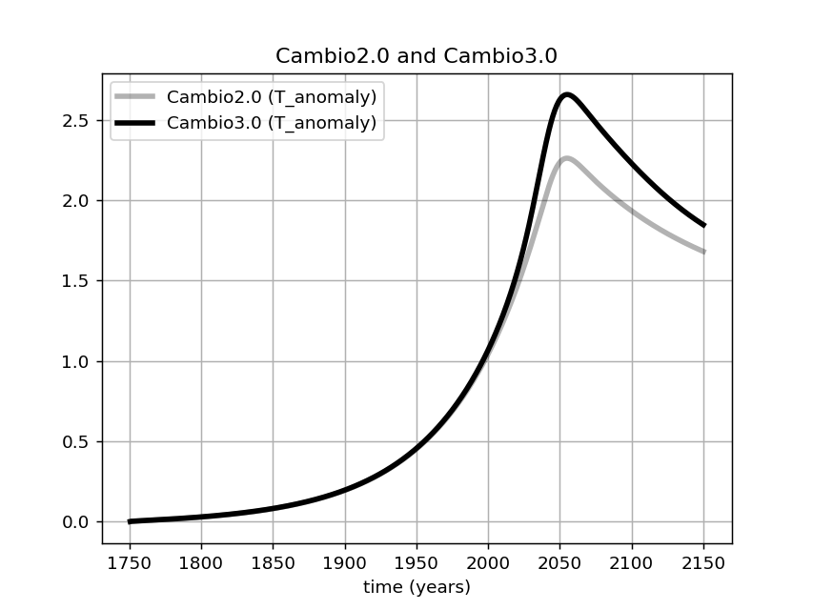
Cambio 3.0 introduces ice/albedo effects … so the temperature impact is big for the same carbon amounts in the atmosphere

Slide 2
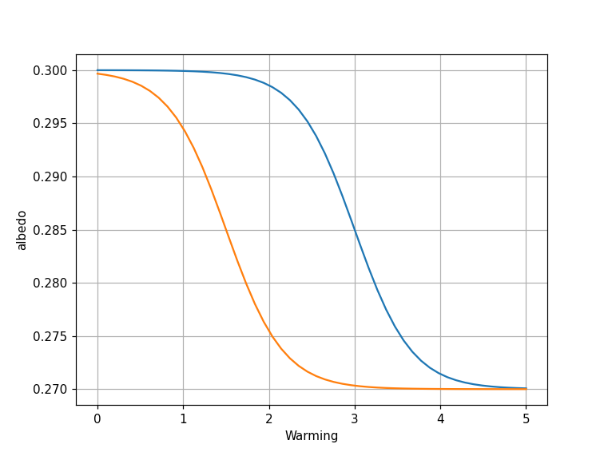
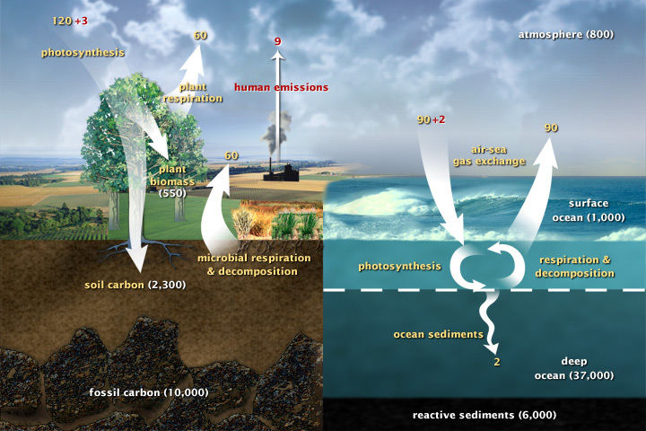


Another project idea: What if the albedo tipping point happens at a lower temperature?
$T_{albedo}^{∗}=3$ degrees
$$T_{albedo}^{∗}=1.5$$
To do this comparison, you’d probably want to stick with the same model (Cambio3 or Cambio4)

Slide 3
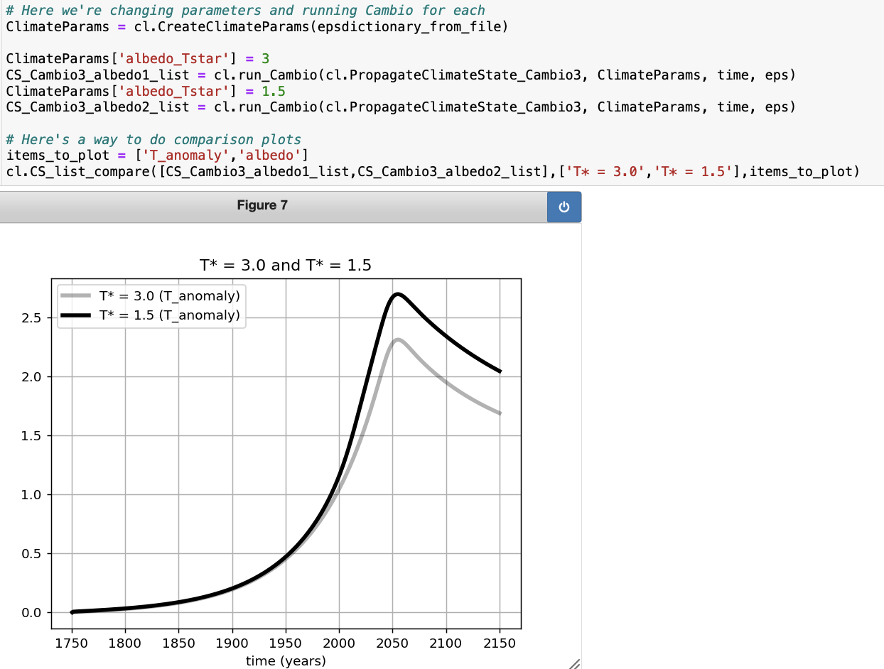
Here’s how you could implement that comparison (using Cambio3)

